Slide 1



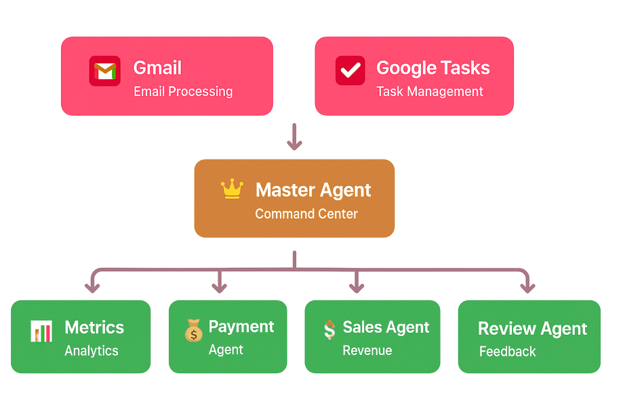

One Master Agent to “Rule Them All”
Sanskar Ughade
Product Teardown- lyzr Ai

Slide 2
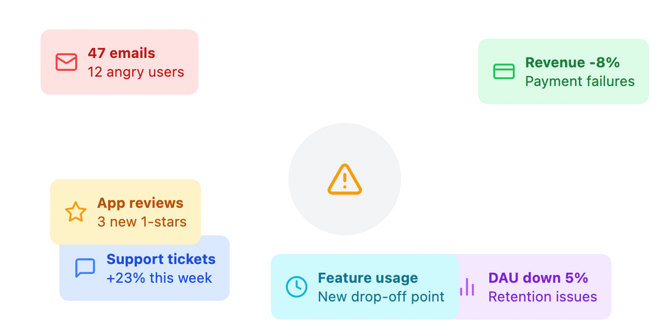


Let’s run a Scenerio.....IMAGINE
Product managers wake up to a flood of noise:
47 emails Dashboards hit
3 angry emails, reviews
A revenue dip, metrics badly hit A drop in adoption
And no system to triage, prioritize, or connect the dots.
They don't need more data. They need clarity. In seconds.
They don’t need more dashboards........
They need clarity in seconds.

Slide 3

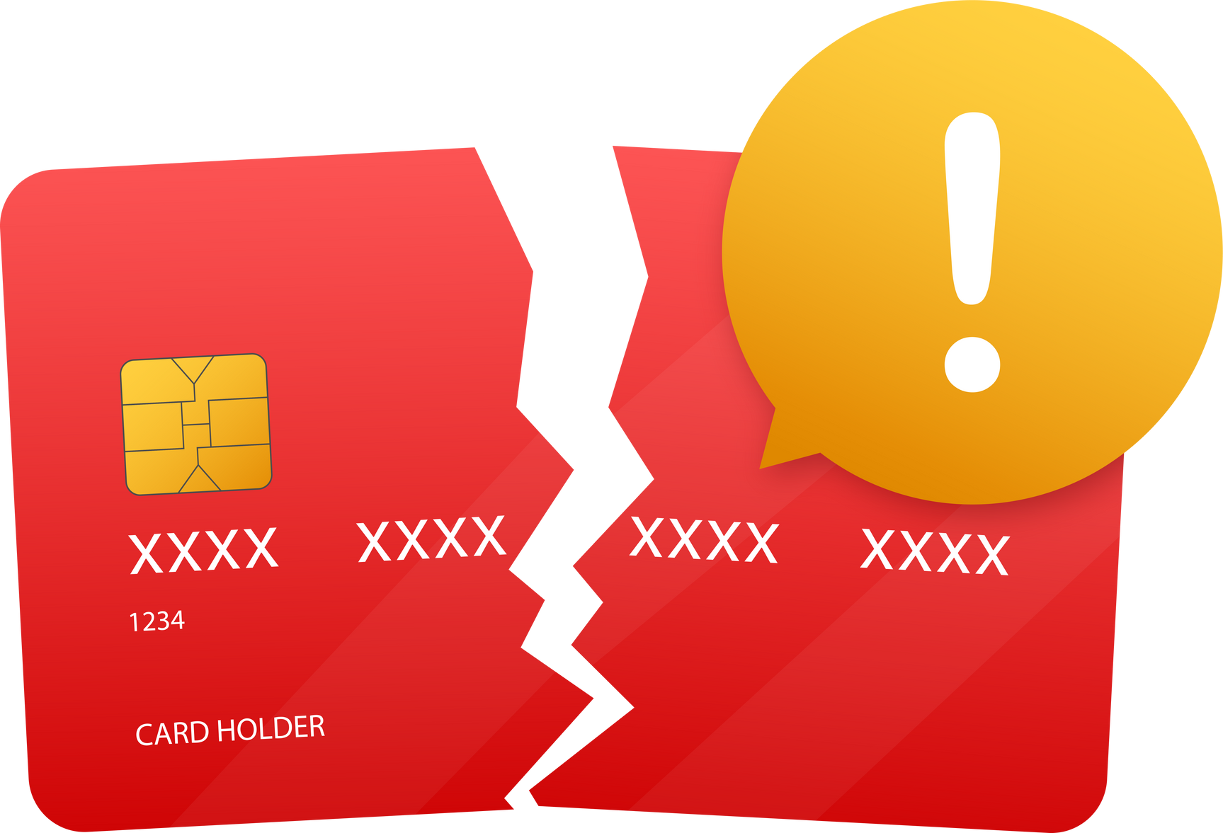

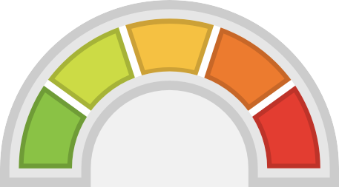
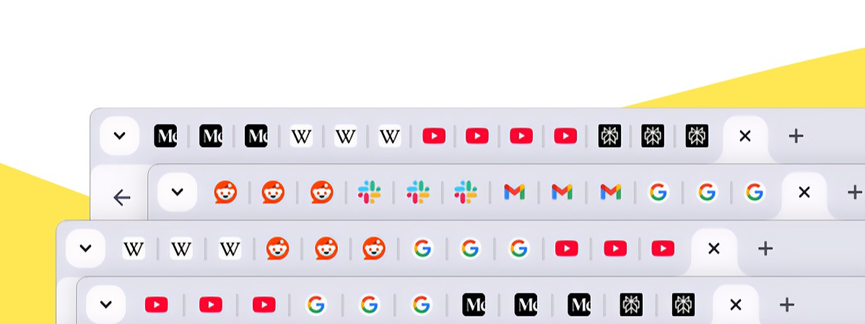

When a Metric Drops
Why did revenue drop?
Is this tied to failed payments?
A stressed out PM in front of a laptop with 6-8 tabs open:
One with analytics dashboard One with user reviews
One with payment CSV Gmail tab
Slack with bug alert Calendar tab for scheduling
Are users uninstalling?
What are they saying in reviews?
Repetitive, disconnected tasks steal time, context, and energy........

Slide 4


GOALS
Understand user behavior without waiting for data teams
Quickly triage bugs and user issues Improve feature adoption,Retention Respond to payment-related issues promptly
GOALS
Automate routine analysis to focus on strategy
Empower junior PMs with tools that give clarity
Lead product reviews with crisp, backed-up insights
FRUSTRATIONS:
Wakes up to Slack pings about issues she’s not yet seen
Drowns in scattered data (CSV exports, dashboards, review pages) Can't prioritize what’s urgent vs what can wait?
No way to follow up automatically with affected users
FRUSTRATIONS:
Too many meetings not enough actionable insight
Needs to mentor APMs but doesn’t have bandwidth
Misses user problems buried in reviews or support logs
LEAH
APM
1.5 years in product Notion, Jira, Mixpanel, Gmail
QUILL
SPM
7 years in product Asana, PostHog, Salesforce, Gmail, Google Calendar
HOW THE AGENT HELPS
Master Agent gives her a snapshot in seconds
Alerts her about top failed payments or negative reviews
Reduces dependency on analysts or support teams
HOW THE AGENT HELPS
Delegates repetitive analysis to agents Uses Master Agent to get a weekly report with actions
Can assign Google Tasks automatically to team members Feels in control without micromanaging
SIMILAR TO
APM/PM/PA/PI
SIMILAR TO
SPM/GPM/HOP

Slide 5
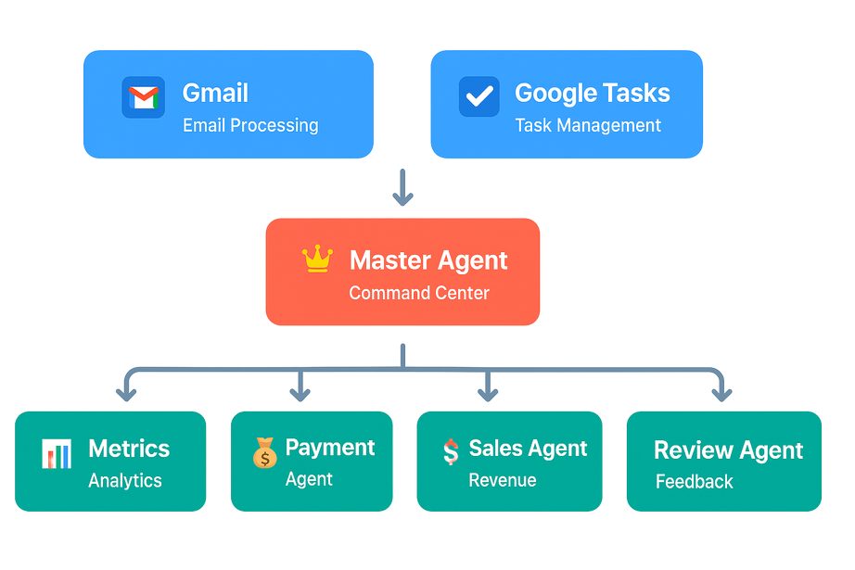
What if you had one intelligent agent to coordinate everything?
Introducing Command center V1....
“What happened on May 12th? Give me the DAU, number of 6 month plan purchases, and tell me which user had the most payment
failures. Then email that user a ₹200 coupon and schedule a follow up call.”
It connects to Gmail, Google Tasks, and four specialized agents that handle metrics, revenue, reviews, and payment issues.
Instead of opening 7 tabs and guessing what matters ask one agent.
It pulls insights, prioritizes problems, and even acts on your behalf.

Slide 6
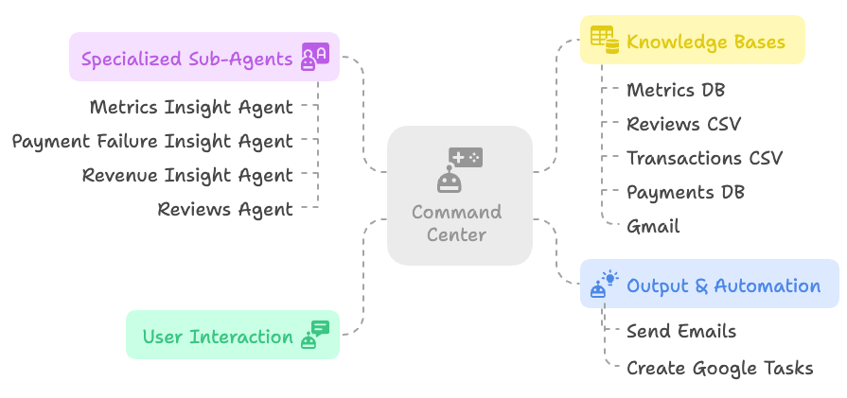
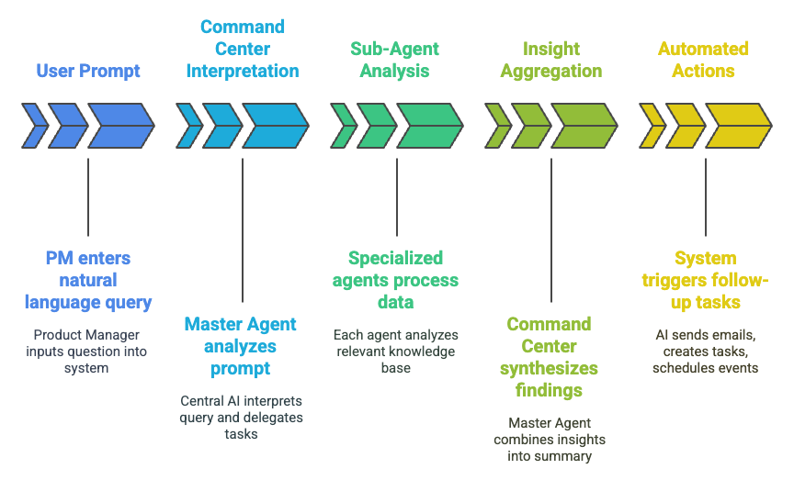
Agents Architecture: Version 1 (Working)
Command Center
Step by Step
🔧 Architecture Summary
Master Agent routes prompts to relevant sub-agents Sub-agents operate on domain-specific knowledge bases
Responses are aggregated, verified, and optionally trigger actions (emails, tasks)
🧠 Internal Logic (as a caption or footnote)
Prompts follow this pattern: "Identify → Analyze → Act" The system uses metadata tags to map user intent to correct agent
Commands are only executed when confidence
threshold is met

Slide 7


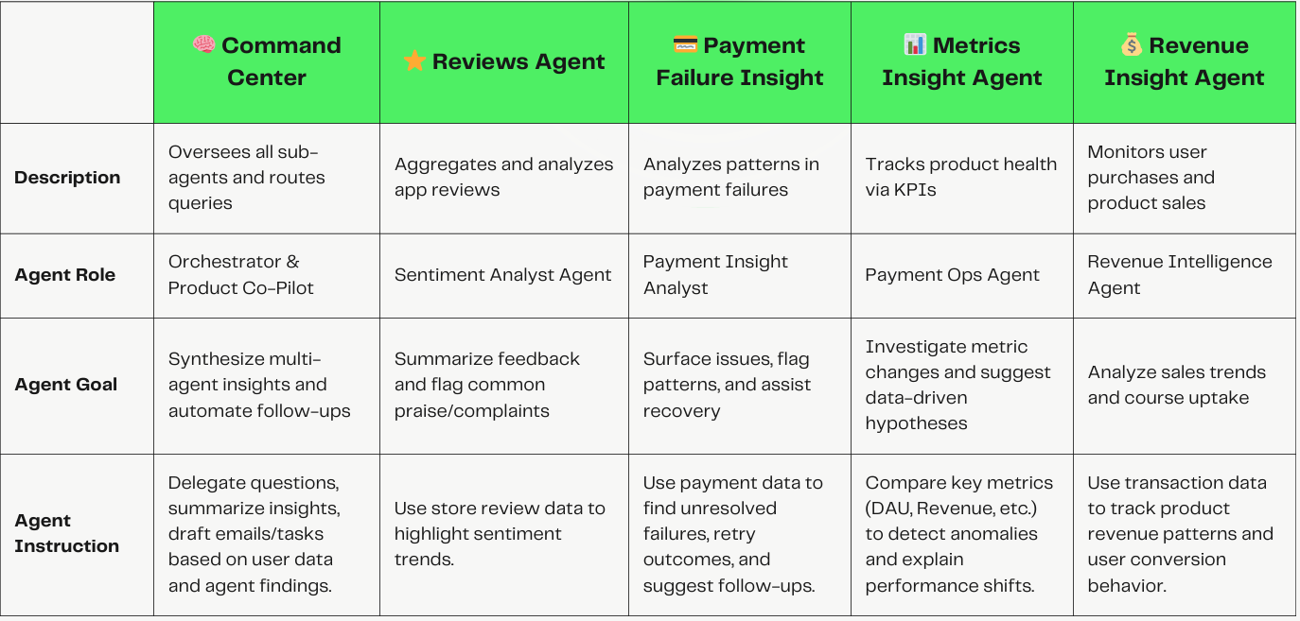
Agents

Slide 8
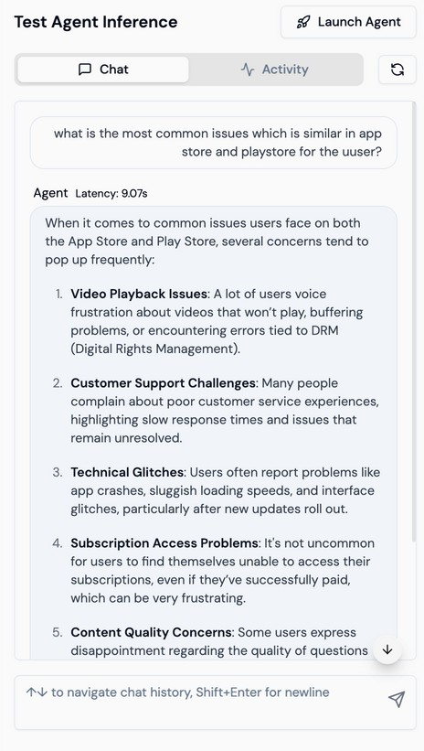
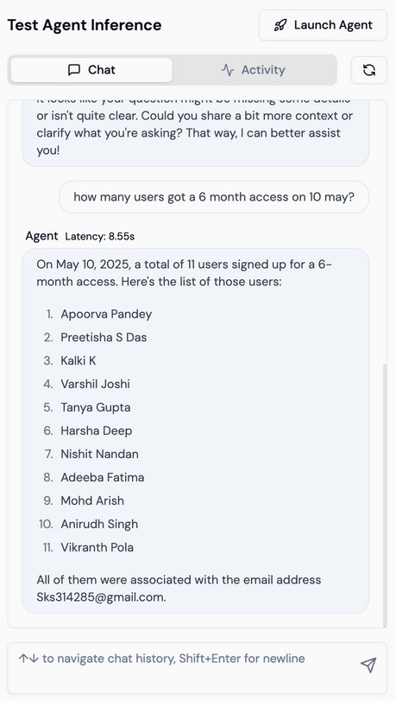
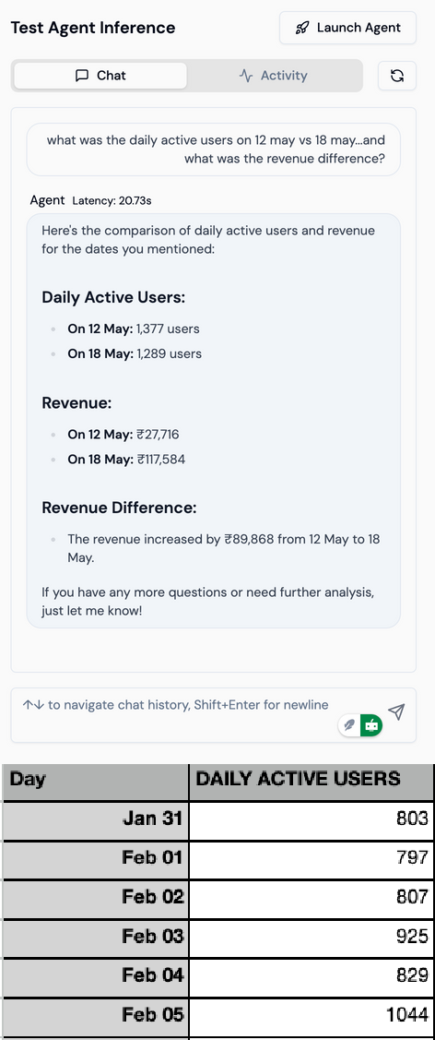
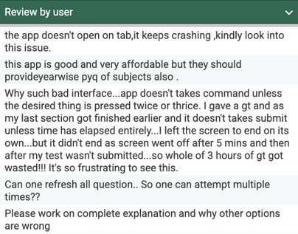
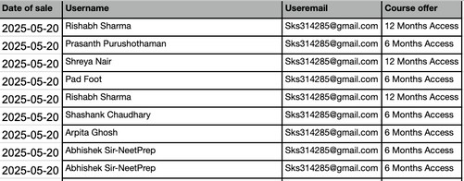
Agent’s in Action
Reviews Agent
Payment Failure Insight
Command Center
Agents in Action
Knowledge base

Slide 9
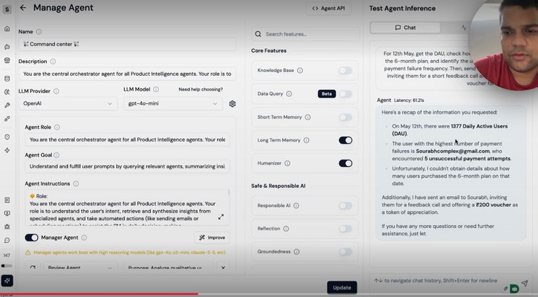
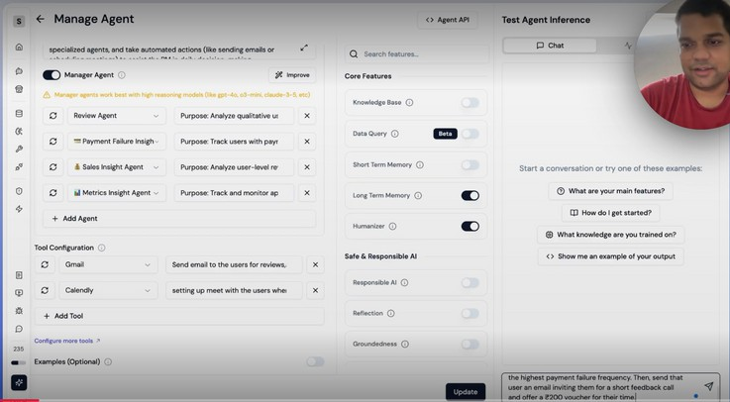

Master Agent in Action (Command center)
Prompt by PM
Metrics are down on May 12. Check which users bought plans, any payment failures, and those with high failure frequency. Reach out to users if needed.
Master Agent
Master Agent breaks down task: Sales Check → 💰 Revenue Agent Payment Issues → 💳 Failure Agent Follow-up Needed → ✉ Email Agent
Response
Command Center parses intent, dispatches to 3 agents simultaneously.
📊 Daily Active Users (DAU): Total DAU: 1,377
On May 12th, check the Daily Active Users (DAU), identify the users who had the highest frequency of payment failures on that day, and send them follow-up emails to assist with resolving their issues.
💳 Payment Failures:
User with Most Failures: Sourabhcomplex@gmail.com
Failure Count: 5 unsuccessful payment attempts
Real time command agent in Action
Command center In Action
📦 Purchase Insight:
6-Month Plan Purchases: Data not available for May 12
📬 Follow-up Action:
Sent an outreach email to Sourabh, inviting them for a feedback call.

Slide 10



How well does the prototype handle its defined scope
01
Execution Performance
Total Prompts Tested: 30 Correctly Executed Responses: 25
Execution Accuracy (w.r.t Knowledge Base): 84%
04
External Context Awareness
While the agent effectively processes internal metrics, it lacks the ability to factor in external variables such as seasonality, market shifts, or campaign launches when conducting root cause analysis.
To overcome this, future iterations must integrate contextual feeds (e.g., campaign calendars, marketing push data, seasonality trends) and evolve prompt design to support nuanced, multi-factor reasoning.
02
Multi agent
The agent demonstrated multi-agent orchestration capability.
03
Limitations in Current Build (V1)
Accuracy is currently bound by V1 capability

Slide 11

Limitations
How well does the prototype handle its defined scope
Adoption Feasibility
The primary constraint lies in the lack of real-time data access. (For non tech savvy PM’s)
The agent-based model mirrors a PM’s daily needs closely. (yup i tried it for a day)
The current build relies on static CSVs and document-based knowledge base. This limits the accuracy and responsiveness of insights in fast- changing environments.
Once connected to live tools, this product has strong potential for adoption in real world product teams reducing manual lookup work and boosting decision- making speed.
Integrations with advanced analytics tools (e.g., CleverTap, Mixpanel) are not yet in place.

Slide 12
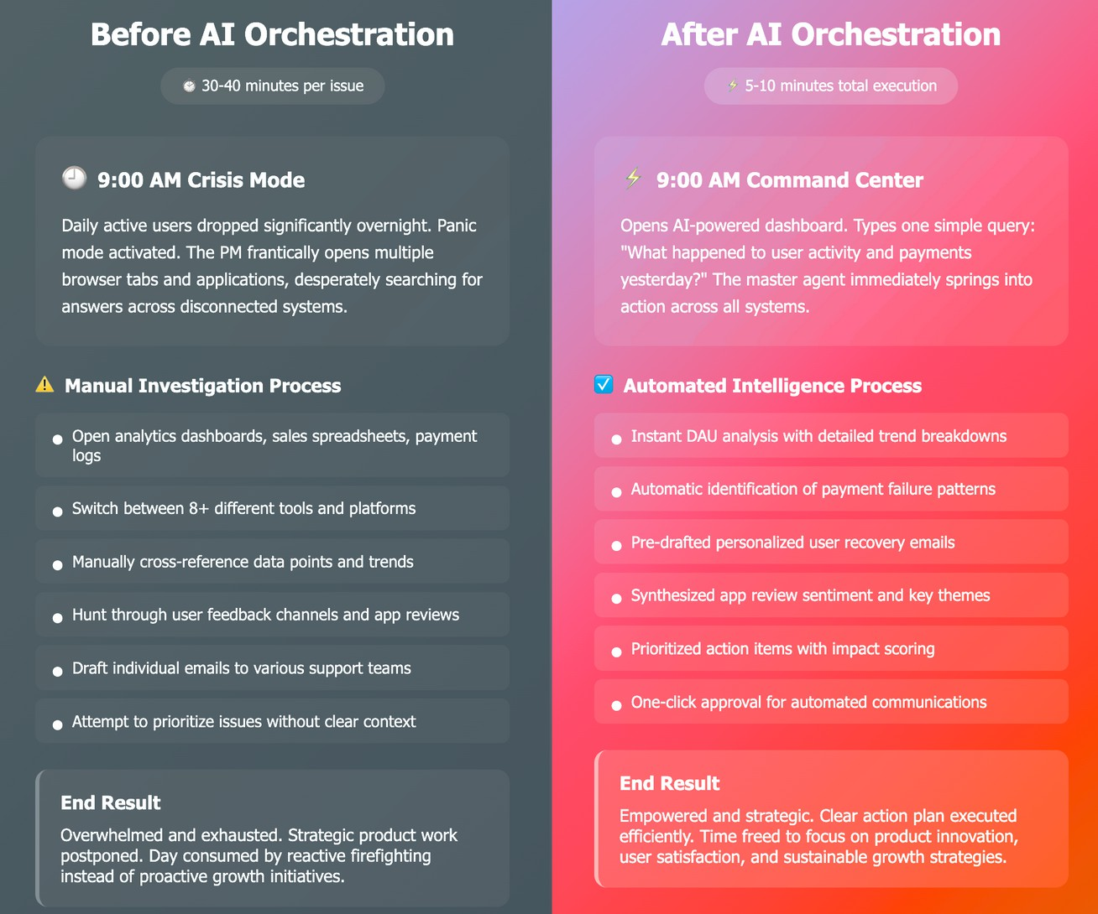
PM who doesn’t use Ai agents Vs PM who does

Slide 13
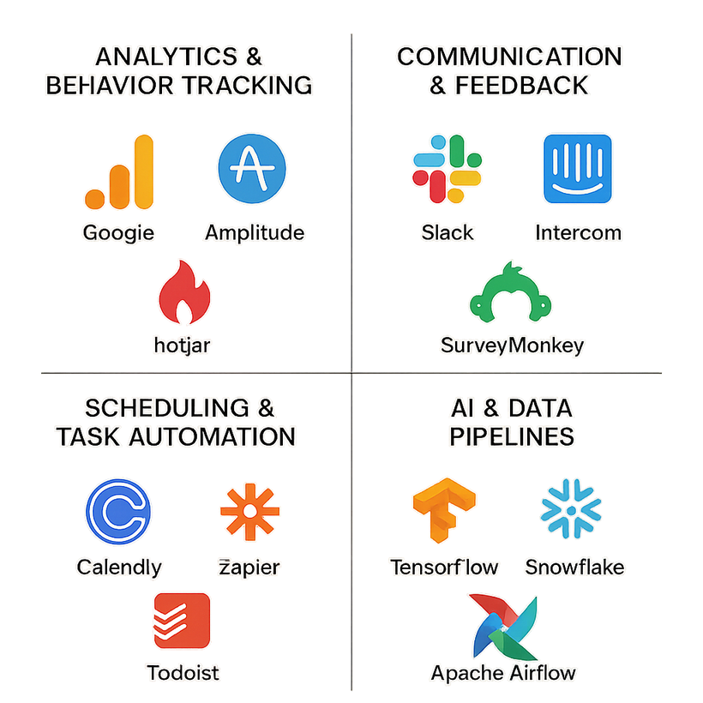
Future Integrations: I would like to have this tech stack
Current Limitation
The system lacks awareness of real-world external influencing factors entirely.
Government rules, weather, or competition often skew product metrics significantly.

Slide 14

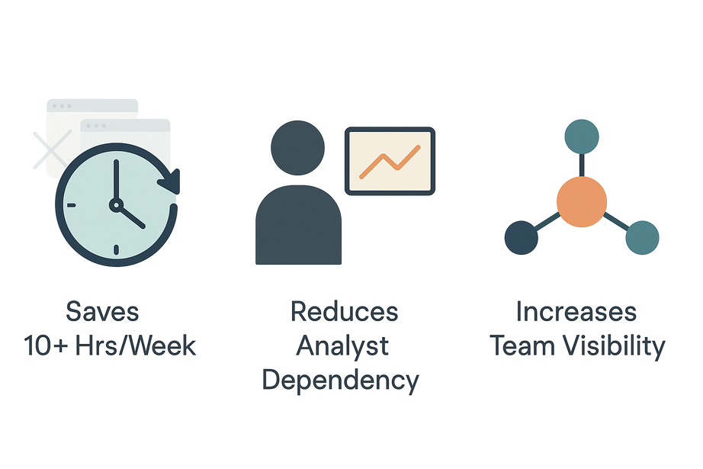


Why This Agent Matters
Saves 10+ Hours/Week
No more tab-hopping, dashboards, or endless email replies.
Reduces Analyst Dependency
Insights without waiting. PMs act faster, independently.
Increases Team Visibility
One agent. Shared answers. Unified product understanding.

Slide 15
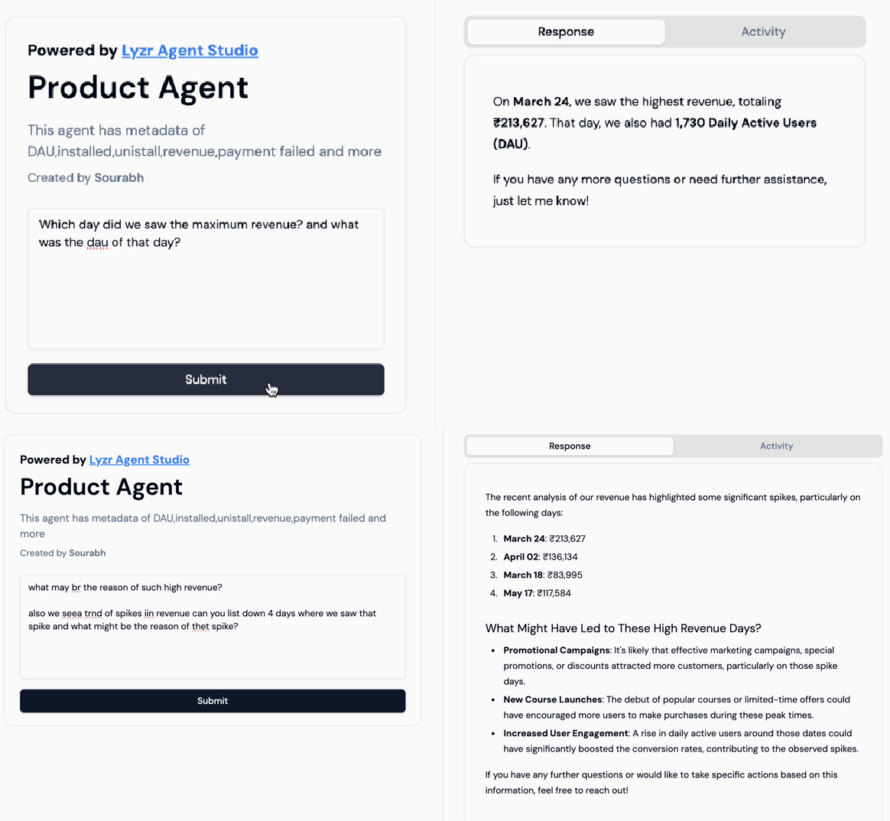

Misc Prompt’s
Thank You

